Slide 1
Capstone Project: Bringing It All Together
By Mohamed Adel Mahmoud Gouda

Slide 2

Agenda
Introduction
Transcribe videos.
Normalization.
Extract Key Phrases.
Create dashboard.

Slide 3
Introduction
Our organization is dedicated to making Machine Learning (ML) accessible for all learners through an introductory course with over 40 videos on essential ML topics.
We are developing an interactive application that allows students to search for specific topics seamlessly.
This dashboard will utilize Amazon Simple Storage Service (Amazon S3) to provide an intuitive interface for quick content discovery.
In this presentation, we will outline the development process, highlight key features, and show how it enhances the efficiency and accessibility of Machine Learning education.

Slide 4
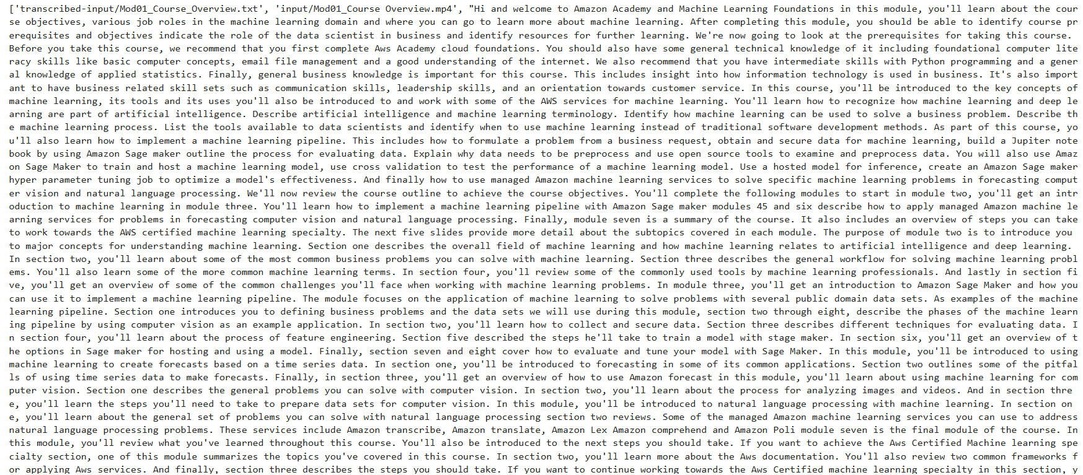
Transcribe videos
AWS Transcribe Client Initialization: initialized using boto3 to interact with AWS Transcribe service.
List Objects in S3 Bucket retrieves all video files from S3 bucket within an input folder.
Start Transcription Jobs.
This workflow allows for automatic transcription of multiple video files and stores
the resulting transcriptions for further use.

Slide 5
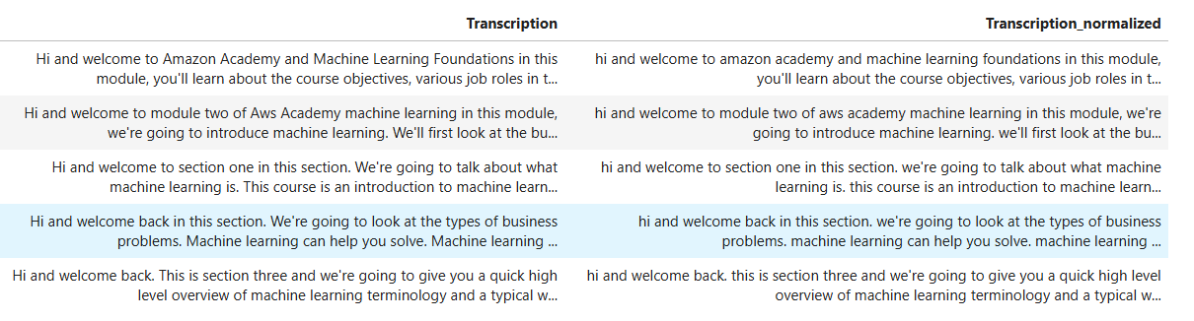
Normalization
We can use regular expression to remove any URL html .
We convert text into lowercase and remove additional white spaces .
Apply all normalization on text transcript.

Slide 6
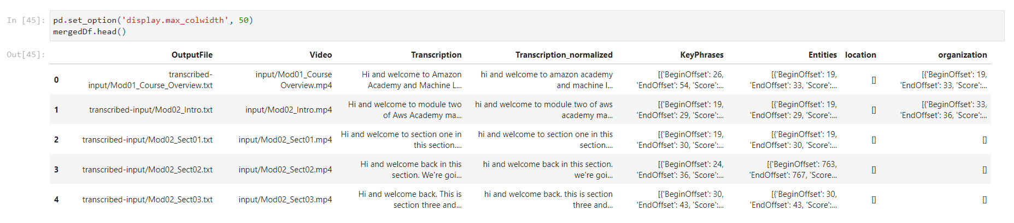
Extract Key phrases
upload a CSV file containing the transcription data to an S3 bucket.
An AWS Comprehend client is initialized using boto3 to interact with the service.
Start Key Phrases Detection Job to represent the most important concepts or ideas in a document or transcription. By extracting these phrases, you can quickly summarize the main points of the content without having to read through the entire transcription.
Start Entities Detection Job to detect entities in the transcription data.

Slide 7
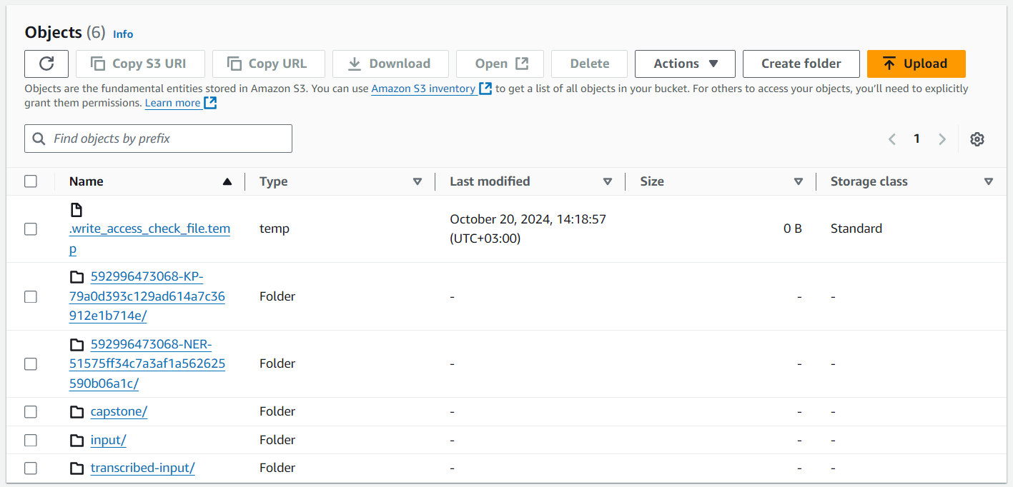

Slide 8
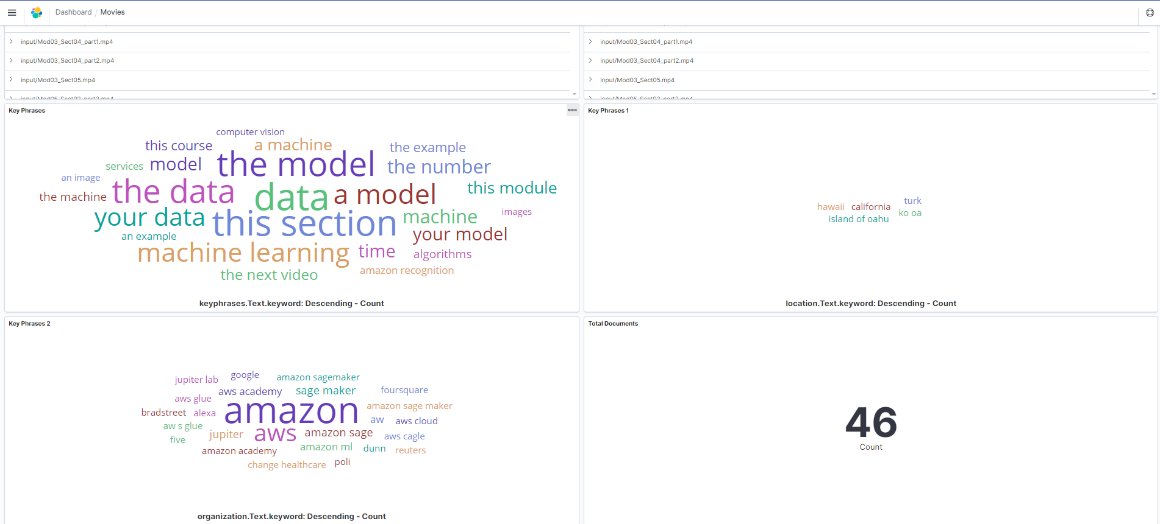
Create Dashboard
Creating a Kibana Dashboard allows you to visualize and interact with the data extracted from video transcriptions, such as key phrases, topics, or other insights. Kibana, part of the ELK (Elasticsearch, Logstash, Kibana) stack, is widely used for creating powerful and interactive data visualizations.

Slide 9
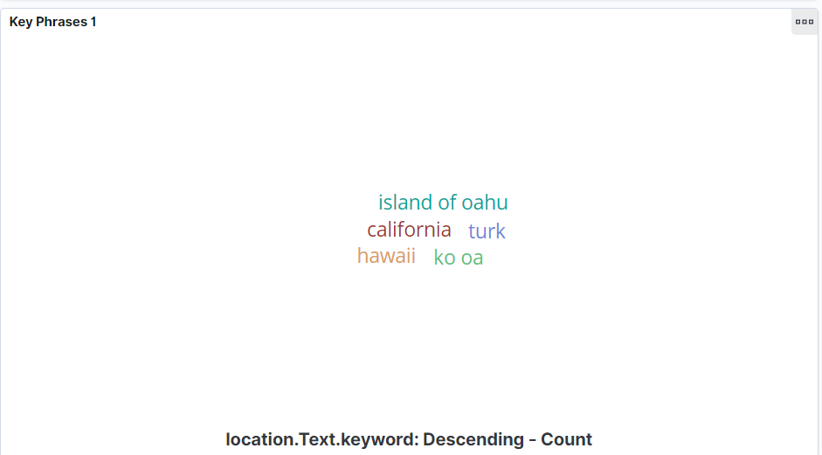
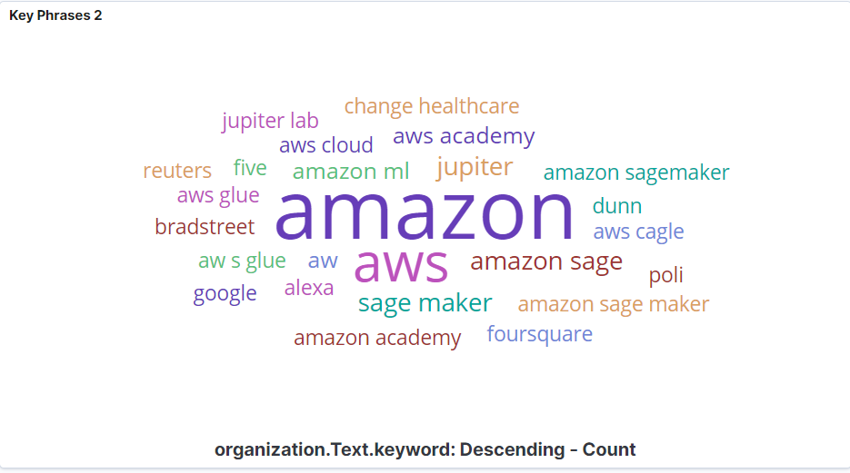
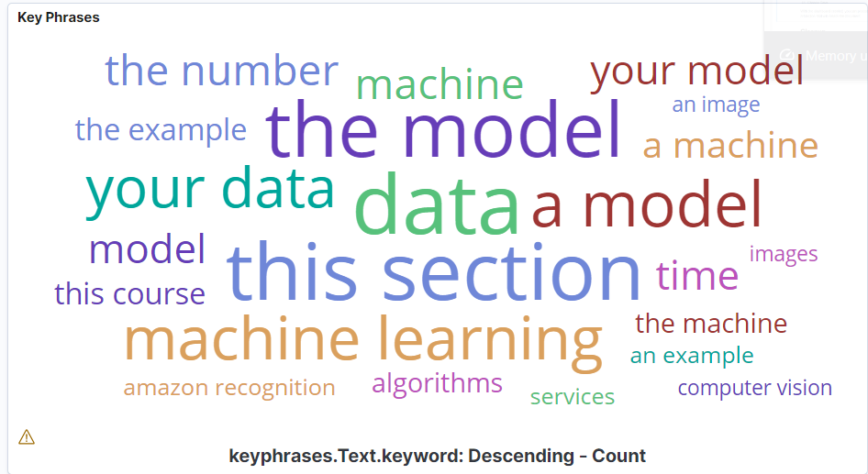
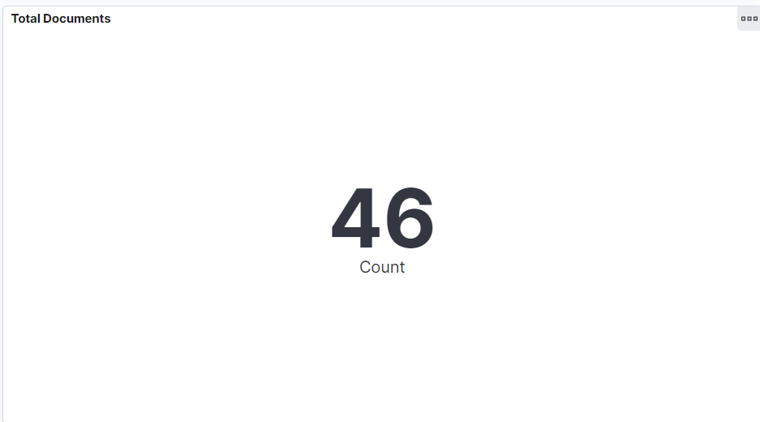

Slide 10

Any Questions

